Slide 1


Slide 2
Docker technology
is one implementation of container based virtualization technologies

Slide 3
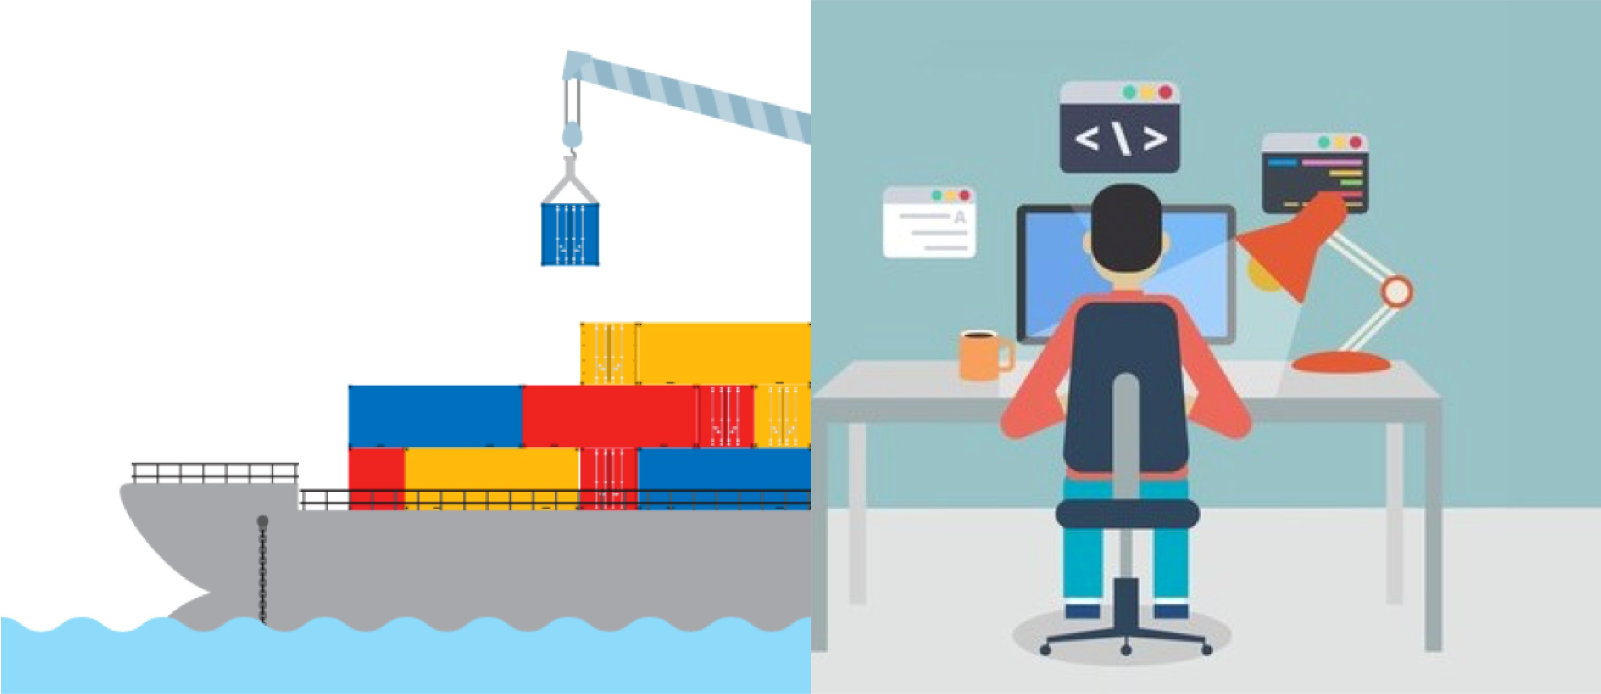

Slide 4
Introduction to Virtualization Technologies

Slide 5





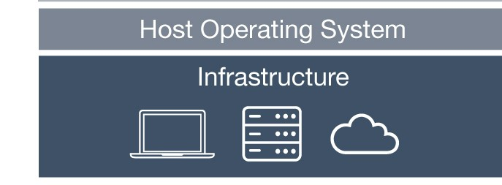
Pre-Virtualization World
Problems:
Huge Cost
Slow Deployment
Hard to Migrate
Pre-Virtualization

Slide 6
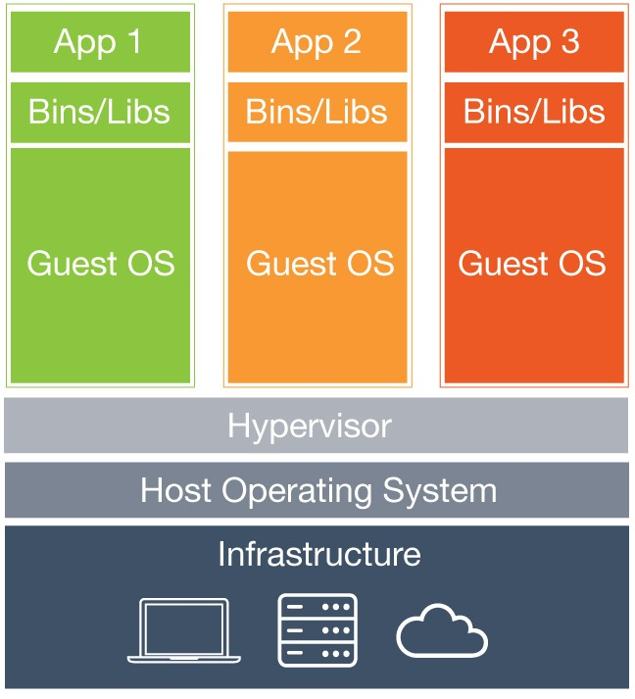
Hypervisor-based Virtualization
Benefits:
Cost-Efficient
Easy to Scale
Limitations:
Kernel Resource Duplication
Application Portability Issue
Hypervisor-based Virtualization

Slide 7

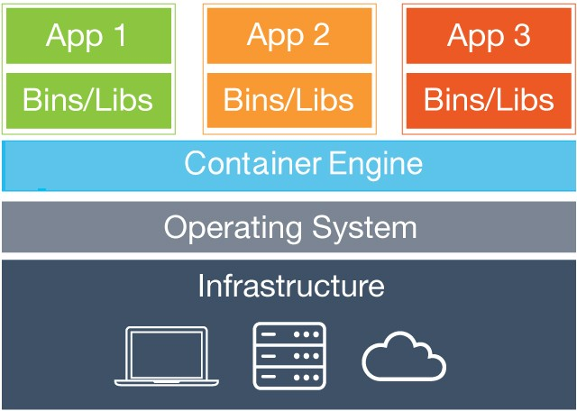
Hypervisor-based VS Container-based Virtualization
Containers
Hypervisor-based Virtualization
Container-based Virtualization

Slide 8














Runtime Isolation
Application A JRE 8 Container A | Application B
 | JRE 7
 | Container B
Container Engine
Operating System/Kernel
Physical Server

Slide 9

Container Virtualization
Benefits:
Containers
Cost-Efficient
Fast Deployment
Guaranteed Portability
Container Virtualization

Slide 10
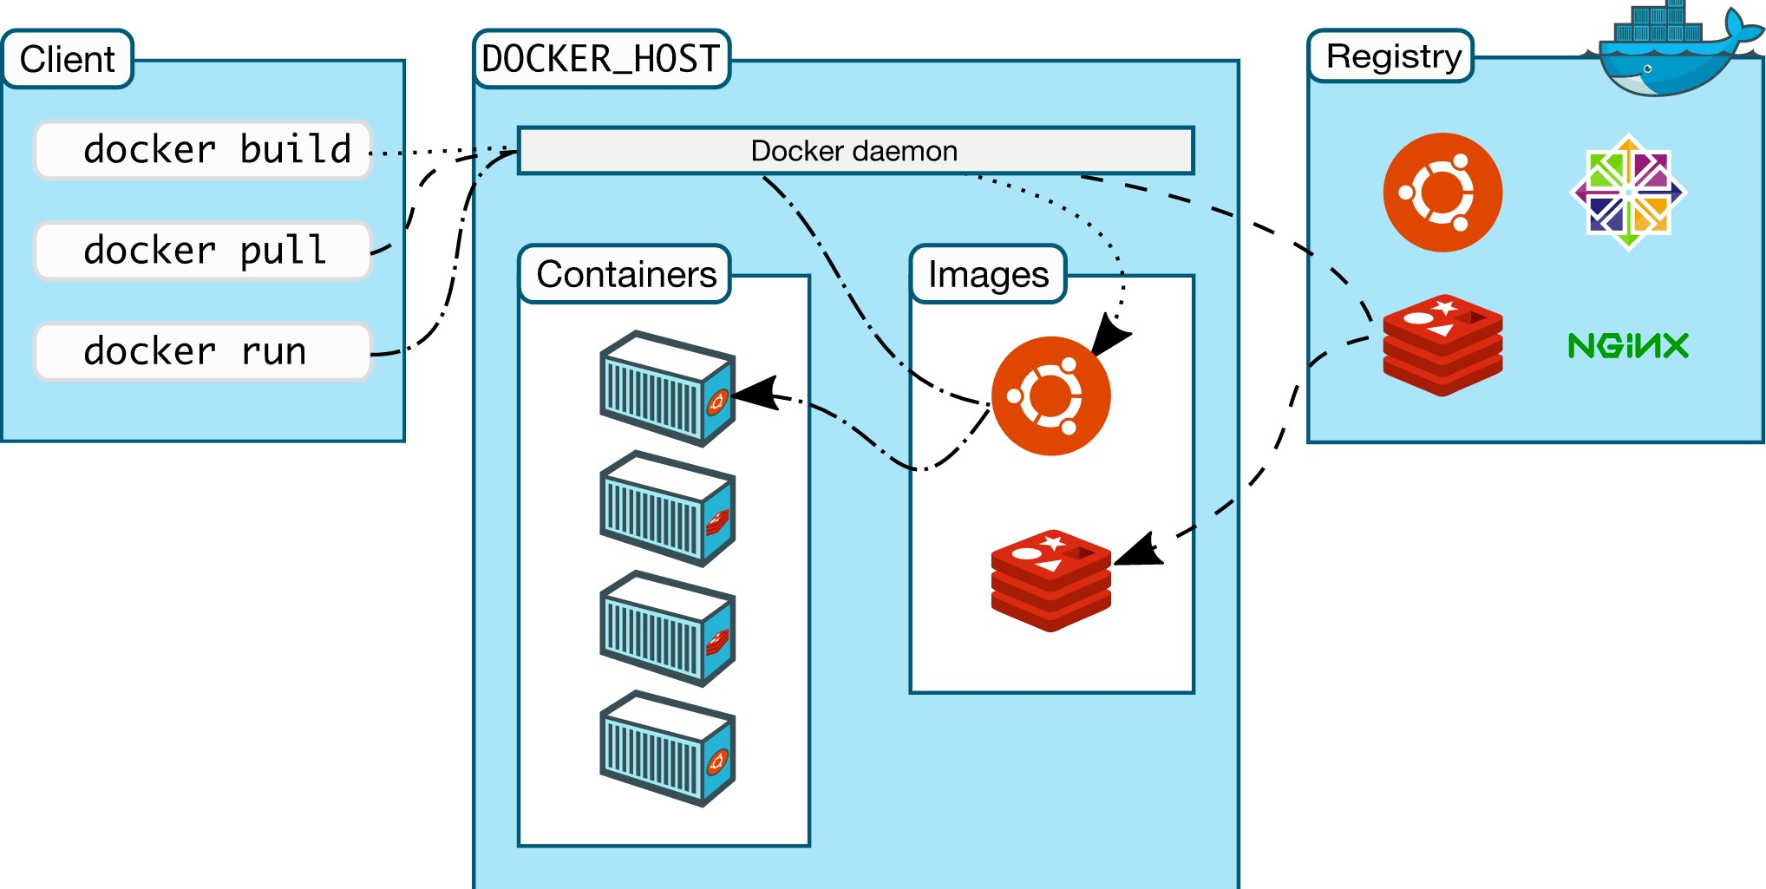

Slide 11
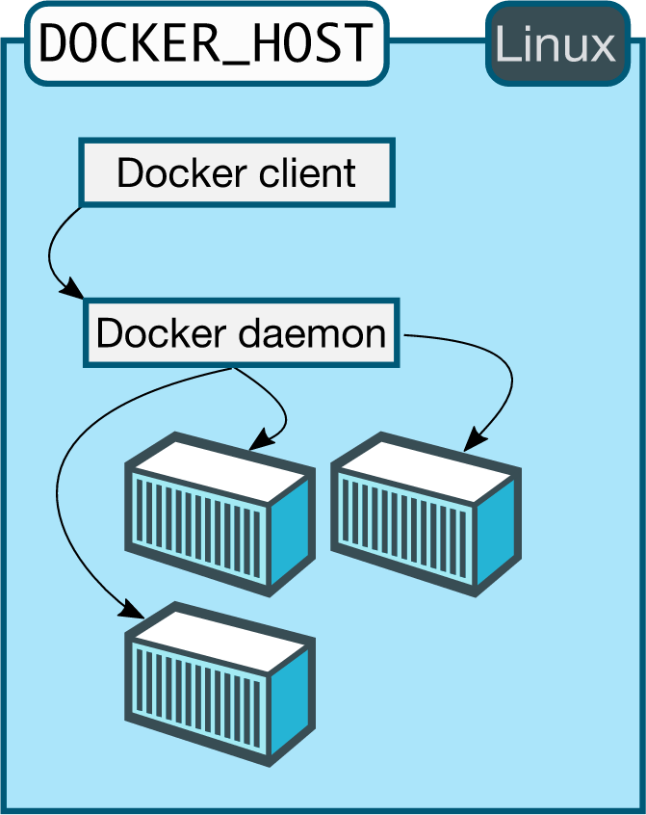
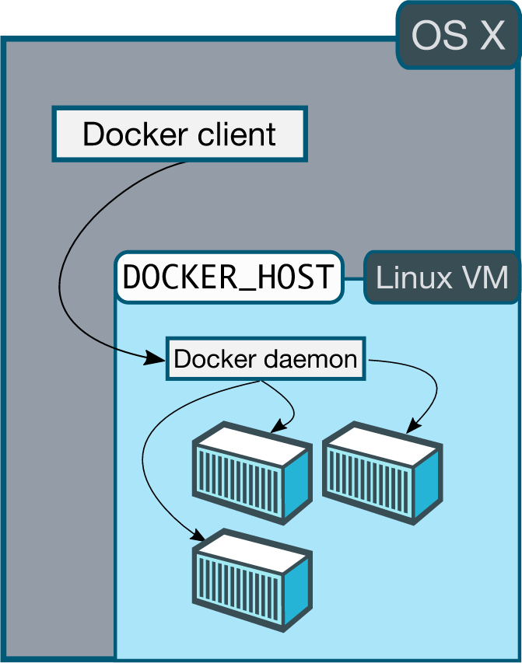

Slide 12
Docker
Client-Server Architecture

Slide 13
Install Docker for Mac/Windows

Slide 14
Install Docker Software
This lecture applies to you if:
You are using Linux
Or you are using Mac and your Mac version is OS X 10.10.3 or newer
Or you are using Windows and your Windows version is Windows 10 or newer
Otherwise, you can skip this lecture and follow the installation guide of the next lecture.

Slide 15
Install Docker Toolbox

Slide 16
Install Docker Toolbox
This lecture applies to you if:
You are using Mac and your Mac version is older than OS X 10.10.3.
Or you are using Windows and your Windows version is older than Windows 10.
Or you want to install Docker Machine or Kitematic instead of Docker Engine.
Otherwise, you can skip this lecture and follow the installation guide of the previous lecture.
If you already installed Docker for Mac/Windows, you can skip this lecture for now.

Slide 17
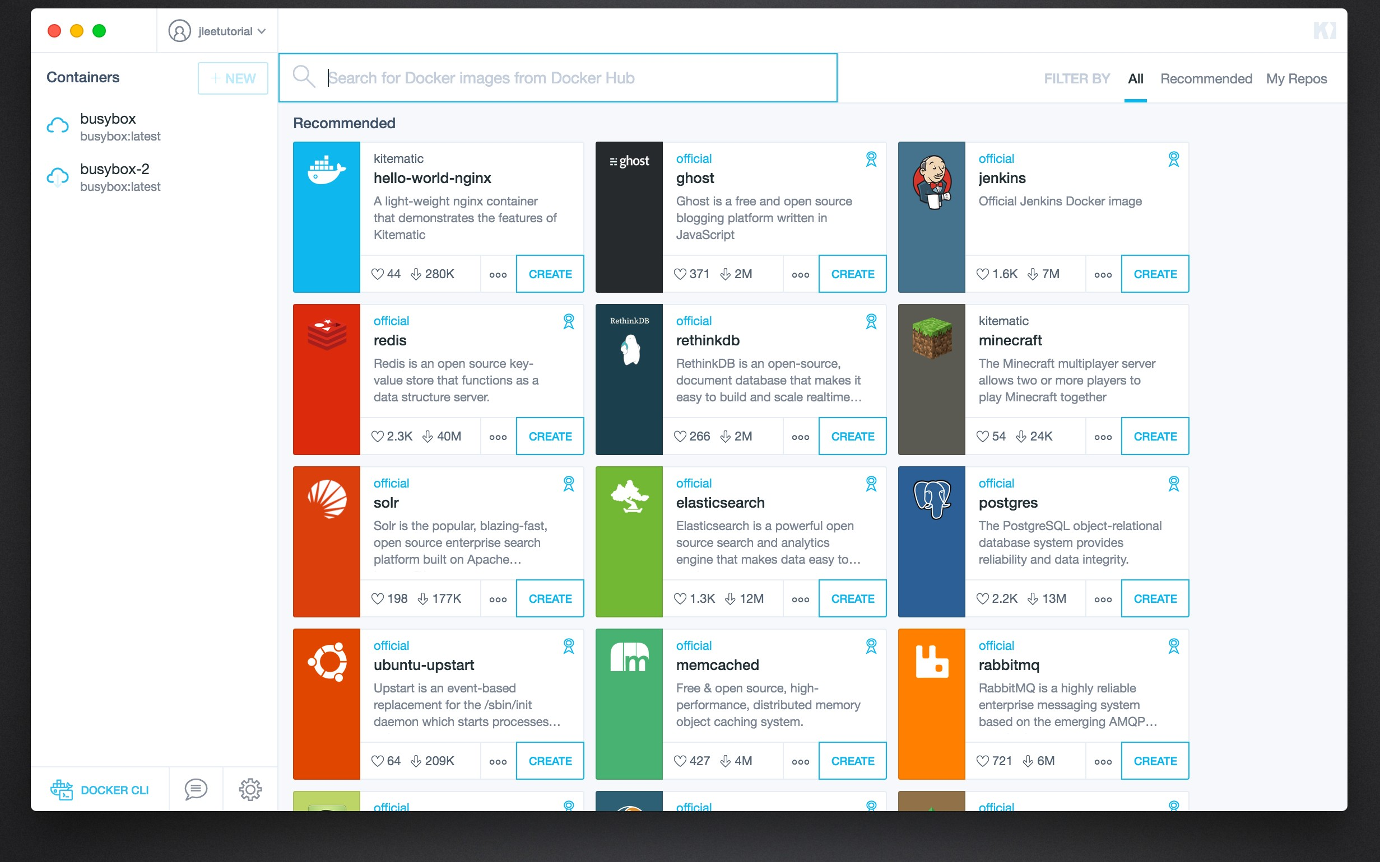

Slide 18
Important Docker Concepts

Slide 19
Images
Images are read only templates used to create containers.
Images are created with the docker build command, either by us or by other docker users.
Images are composed of layers of other images.
Images are stored in a Docker registry.

Slide 20
Containers
If an image is a class, then a container is an instance of a class - a runtime object.
Containers are lightweight and portable encapsulations of an environment in which to run applications.
Containers are created from images. Inside a container, it has all the binaries and dependencies needed to run the application.

Slide 21
Registries and Repositories
A registry is where we store our images.
You can host your own registry, or you can use Docker’s public registry which is called DockerHub.
Inside a registry, images are stored in repositories.
Docker repository is a collection of different docker images with the same name, that have different tags, each tag usually represents a different version of the image.

Slide 22
Why Using Official Images
Clear Documentation
Dedicated Team for Reviewing Image Content
Security Update in a Timely Manner

Slide 23
Run our First Hello World Docker Container

Slide 24
Deep Dive into Docker Containers
running containers in detached mode
Docker container ps command
docker container name
docker inspect command

Slide 25
 | Run Container in Foreground | Run Container in Background
Description | Docker run starts the process in the container and attaches the console to the process’s standard input, output, and standard error. | Containers started in detached mode and exit when the root process used to run the container exits.
How to specify? | default mode | -d option
Can the console be used for other commands after the container is started up? | No | Yes

Slide 26
Docker Port Mapping and Docker Logs

Slide 27
Docker Image Layers

Slide 28
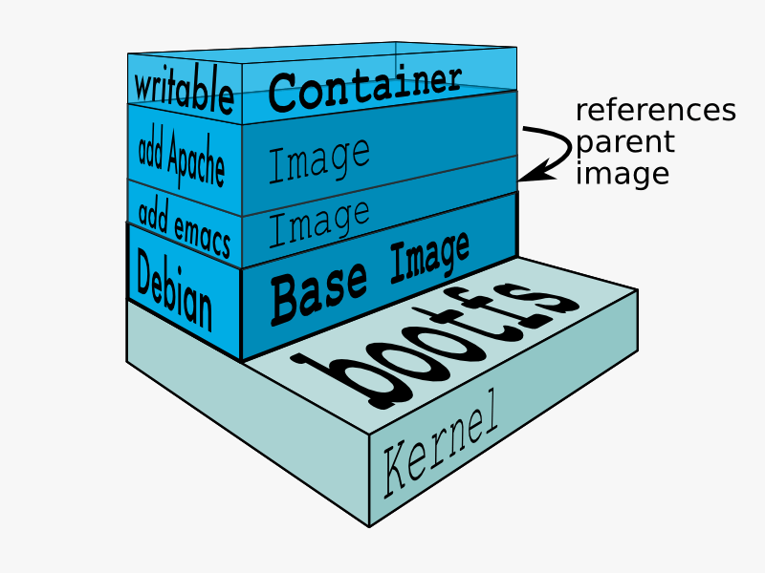
Image Layers

Slide 29
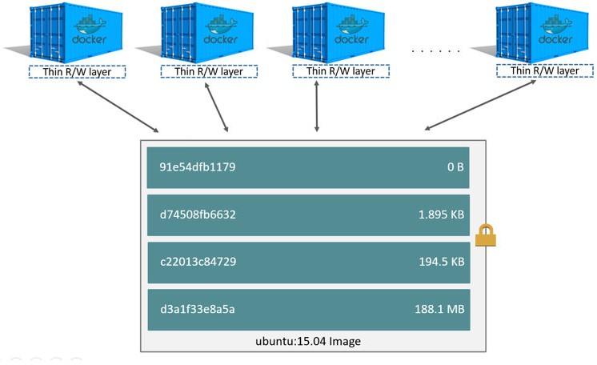
Image Layers

Slide 30
Build Docker Images
Approach 1: committing changes made in a container

Slide 31
Ways to Build a Docker Image
Commit changes made in a Docker container.
Write a Dockerfile.

Slide 32
Steps
Spin up a container from a base image.
Install Git package in the container.
Commit changes made in the container.

Slide 33
Docker commit
Docker commit command would save the changes we made to the Docker container’s file system to a new image.
docker commit
container_ID
repository_name:tag

Slide 34
Build Docker Images
Approach 2: Writing a Dockerfile

Slide 35
Dockerfile and Instructions
A Dockerfile is a text document that contains all the instructions users provide to assemble an image.
Each instruction will create a new image layer to the image.
Instructions specify what to do when building the image.

Slide 36
Docker Build Context
Docker build command takes the path to the build context as an argument.
When build starts, docker client would pack all the files in the build context into a tarball then transfer the tarball file to the daemon.
By default, docker would search for the Dockerfile in the build context path.

Slide 37
Dockerfile In Depth

Slide 38
Steps
Spin up a container from a base image.
Install Git package in the container.
Commit changes made in the container.

Slide 39
Chain RUN Instructions
Each RUN command will execute the command on the top writable layer of the container, then commit the container as a new image.
The new image is used for the next step in the Dockerfile. So each RUN instruction will create a new image layer.
It is recommended to chain the RUN instructions in the Dockerfile to reduce the number of image layers it creates.

Slide 40
Sort Multi-line Arguments Alphanumerically
This will help you avoid duplication of packages and make the list much easier to update.

Slide 41
CMD Instructions
CMD instruction specifies what command you want to run when the container starts up.
If we don't specify CMD instruction in the Dockerfile, Docker will use the default command defined in the base image.
The CMD instruction doesn’t run when building the image, it only runs when the container starts up.
You can specify the command in either exec form which is preferred or in shell form.

Slide 42
Docker Cache
Each time Docker executes an instruction it builds a new image layer.
The next time, if the instruction doesn't change, Docker will simply reuse the existing layer.

Slide 43
Docker Cache
Each time Docker executes an instruction it builds a new image layer.
The next time, if the instruction doesn't change, Docker will simply reuse the existing layer.

Slide 44
Dockerfile with Aggressive Caching
FROM ubuntu:14.04
reusing cache
RUN apt-get update
reusing cache
RUN apt-get install -y git
curl

Slide 45
Cache Busting
FROM ubuntu:14.04
RUN apt-get update && apt-get install -y \ git \
curl

Slide 46
Cache Busting
You can also achieve cache-busting by specifying a package version. This is known as version pinning.
RUN apt-get update && apt-get install -y \ package-bar \
package-baz \ package-foo=1.3.*

Slide 47
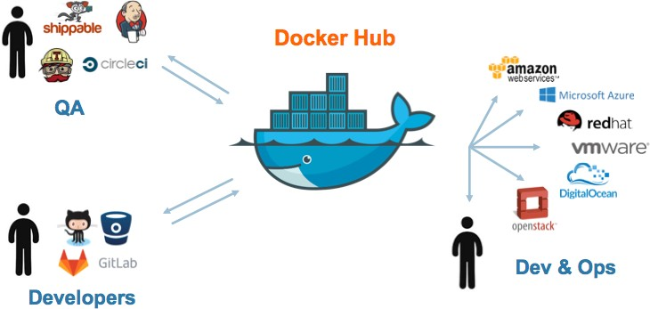
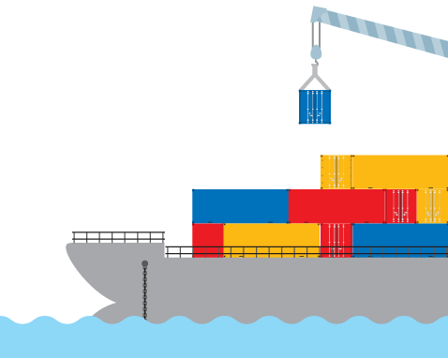

Slide 48
Containerize a Hello World Web Application

Slide 49
Docker Container Links

Slide 50
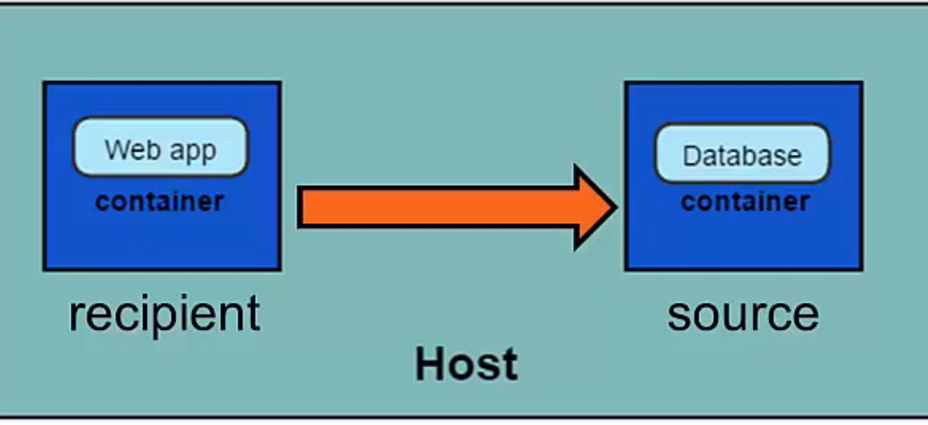
Docker Container Links
Dockerapp
Redis

Slide 51
How container links work behind the scenes?

Slide 52
Benefits of Docker Container Links
The main use for docker container links is when we build an application with a microservice architecture, we are able to run many independent components in different containers.
Docker creates a secure tunnel between the containers that doesn’t need to expose any ports externally on the container.

Slide 53
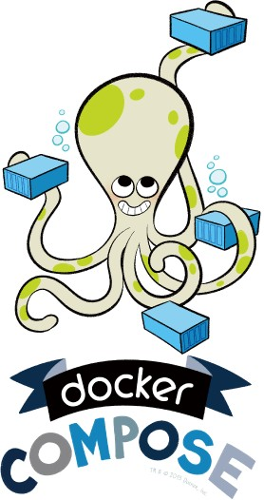
Automate the Docker Workflow with Docker Compose

Slide 54
Deep Dive into Docker Compose Workflow

Slide 55
Why Docker Compose?
Manual linking containers and configuring services become impractical when the number of containers grows.

Slide 56
Docker Compose
Docker compose is a very handy tool to quickly get docker environment up and running.
Docker compose uses yaml files to store the configuration of all the containers, which removes the burden to maintain our scripts for docker orchestration.

Slide 57
Docker Compose Commands
docker compose up starts up all the containers.
docker compose ps checks the status of the containers managed by docker compose.
docker compose logs outputs colored and aggregated logs for the compose-managed containers.
docker compose logs with dash f option outputs appended log when the log grows.
docker compose logs with the container name in the end outputs the logs of a specific container.
docker compose stop stops all the running containers without removing them.
docker compose rm removes all the containers.
docker compose build rebuilds all the images.

Slide 58
Introduction to Docker Networking

Slide 59
Docker Network Types
Closed Network / None Network
Bridge Network
Host Network
Overlay Network

Slide 60
None Network

Slide 61





None Network
Isolated
Isolated
Isolated

Slide 62
None Network
Provides the maximum level of network protection.
Not a good choice if network or Internet connection is required.
Suites well where the container require the maximum level of network security and network access is not necessary.

Slide 63
Bridge Network

Slide 64
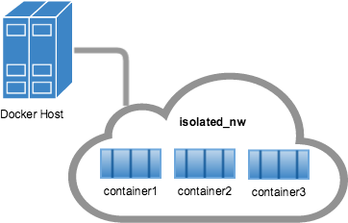
Bridge Network

Slide 65
















Bridge Network
Container B
Container Private Network Interface
Container Private Network Interface
Bridge (docker0)
Host
Internet

Slide 66
Host and Overlay Network

Slide 67
Host Network
The least protected network model, it adds a container on the host's network stack.
Containers deployed on the host stack have full access to the host's interface.
This kind of containers are usually called open containers.

Slide 68
Host Network
Minimum network security level.
No isolation on this type of open containers, thus leave the container widely unprotected.
Containers running in the host network stack should see a higher level of performance than those traversing the docker0 bridge and iptables port mappings.

Slide 69
Define Container Networks with Docker Compose

Slide 70
Write and Run Unit Tests in Docker Containers

Slide 71
Unit Tests in Containers
Unit tests should test some basic functionality of our docker app code, with no reliance on external services.
Unit tests should run as quickly as possible so that developers can iterate much faster without being blocked by waiting for the tests results.
Docker containers can spin up in seconds and can create a clean and isolated environment which is great tool to run unit tests with.

Slide 72
Incorporating Unit Tests into Docker Images
Pros:
A single image is used through development, testing and production, which greatly ensures the reliability of our tests.
Cons:
It increases the size of the image.

Slide 73
Fit Docker Technology into Continuous Integration(CI) Process

Slide 74
What is Continuous Integration?
Continuous integration is a software engineering practice in which isolated changes are immediately tested and reported when they are added to a larger code base.
The goal of Continuous integration is to provide rapid feedback so that if a defect is introduced into the code base, it can be identified and corrected as soon as possible.

Slide 75
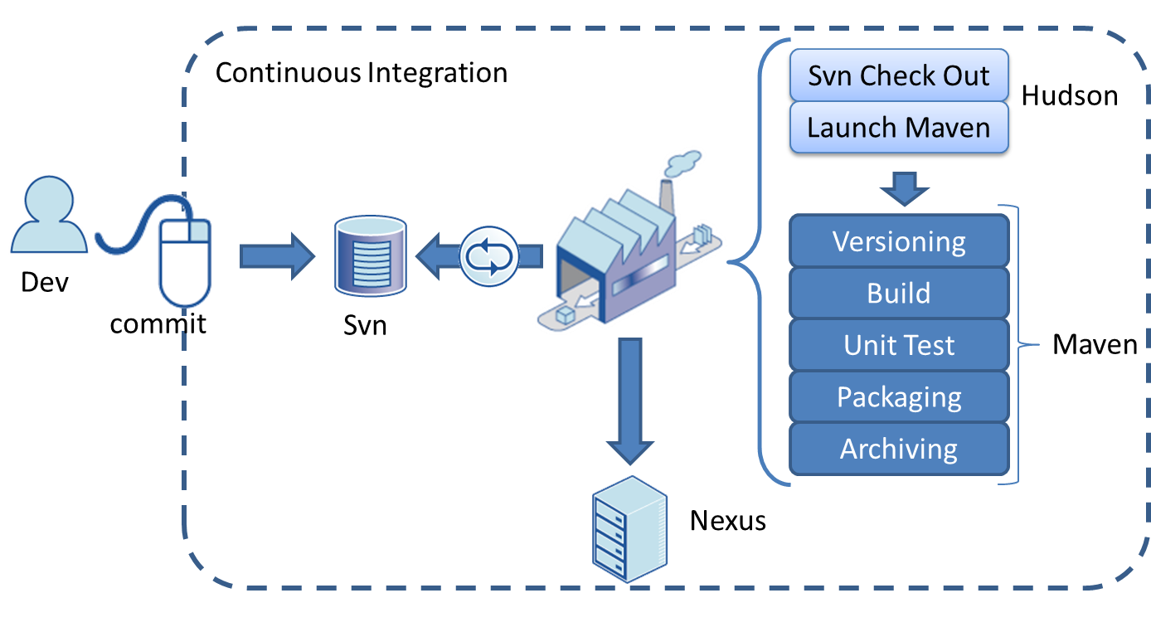


A Typical CI Pipeline without Docker
Check out source code
Continuous Integration Server
Production Servers
Version control system

Slide 76
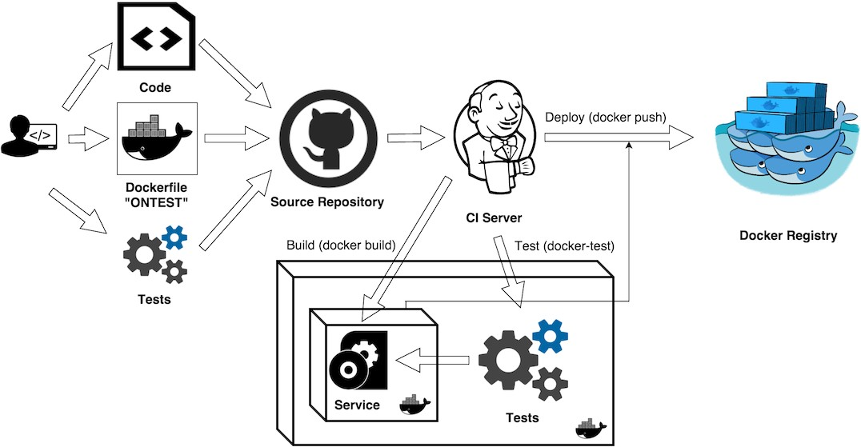
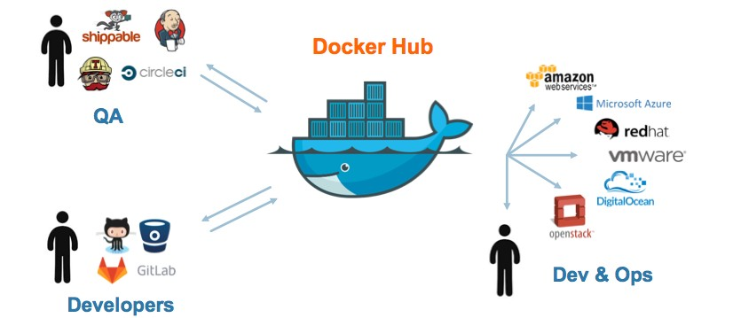
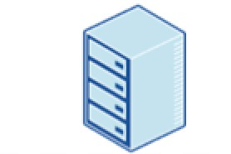
CI process with Docker technologies involved
Pull docker images
Staging / Production

Slide 77
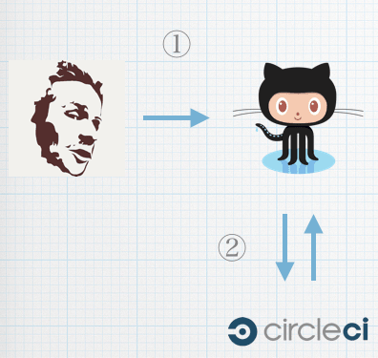
Our Continuous Integration Pipeline
Github
Central Repository for Version Control
Hosted Continuous Integration Server

Slide 78
Text Direction: Introduction to Continuous Integration
URL of the Github account to fork:
https://github.com/jleetutorial/dockerapp
Checking for existing SSH keys:
https://help.github.com/articles/checking-for-existing-ssh-keys/
Generating a new SSH key and adding it to the ssh-agent: https://help.github.com/articles/generating-a-new-ssh-key-and-adding-it-to- the-ssh-agent
Adding a new SSH key to your GitHub account: https://help.github.com/articles/adding-a-new-ssh-key-to-your-github- account/

Slide 79
Link Circle CI with GitHub Account
to build a Continuous Integration pipeline

Slide 80
Set up SSH keys for Github Account
SSH keys are a way to identify trusted computers without involving password.
Generate a SSH key pair and save the private SSH key in your local box and add the public key to your GitHub account.
Then you can directly push your changes to github repository without typing password.

Slide 81
How to check if SSH public key files are available on your local box?
The SSH public key file usually sits under ~/.ssh/ directory and ends with
.pub extension.

Slide 82
Link Circle CI with GitHub Account

Slide 83
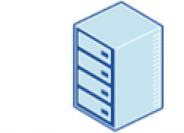
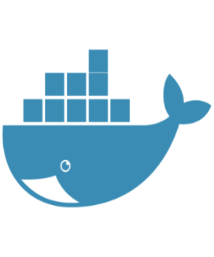
Complete CI Workflow
Github
Central Repository for Version Control
Staging / Production
Pull Docker image
Publish Docker image
Docker Hub
Hosted Continuous Integration Server

Slide 84
Tag the Docker Images with Two Tags
commit hash of the source code
latest

Slide 85
Introduction to Running Docker in Production

Slide 86
Opinions about Running Docker in Production
One one hand, many docker pioneers are confident that a distributed web app can be deployed at scale using Docker and have incorporated Docker into their production environment.
On the other hand, there are still some people who are reluctant to use Docker in production as they think docker workflow is too complex or unstable for real life use cases.

Slide 87
Is Docker Production Ready Now?

Slide 88
Concerns about Running Docker in Production
There are still some missing pieces about Docker around data persistence, networking, security and identity management.
The ecosystem of supporting Dockerized applications in production such as tools for monitoring and logging are still not fully ready yet.

Slide 89



Companies which already run Docker in Production

Slide 90
Why Running Docker Containers inside VMs?
To address security concerns.
Hardware level isolation.

Slide 91
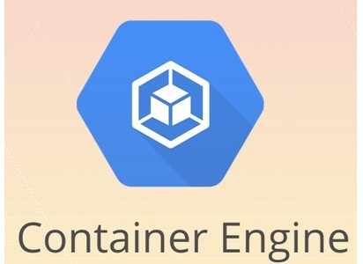
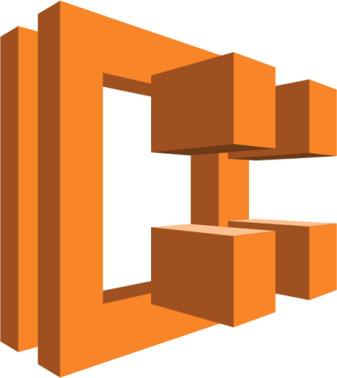
They all run containers inside VMs

Slide 92



Docker Machine

Slide 93
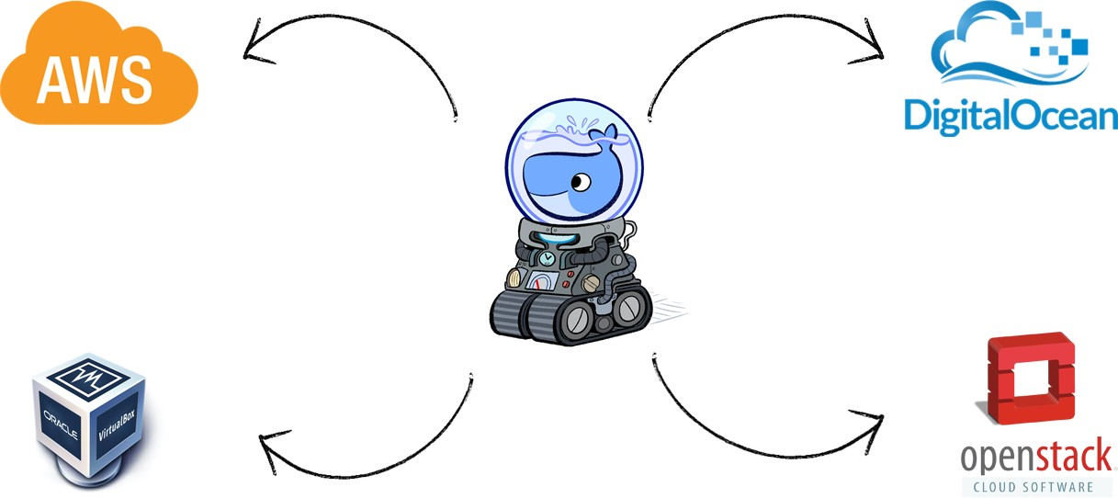


Slide 94



Slide 95
Register Digital Ocean Account to Deploy Containerized Applications

Slide 96
Deploy Docker App to the Cloud with Docker Machine

Slide 97
Text Direction: Deploy Docker App to the Cloud with Docker Machine
Docker Machine Create command
docker-machine create --driver digitalocean --digitalocean-access-token
<xxxxx> docker-app-machine

Slide 98
Introduction to Docker Swarm and
Set up Swarm cluster

Slide 99
How Swarm cluster works
To deploy your application to a swarm, you submit your service to a manager node.
The manager node dispatches units of work called tasks to worker nodes.
Manager nodes also perform the orchestration and cluster management functions required to maintain the desired state of the swarm.
Worker nodes receive and execute tasks dispatched from manager nodes.
An agent runs on each worker node and reports on the tasks assigned to it. The worker node notifies the manager node of the current state of its assigned tasks so that the manager can maintain the desired state of each worker.

Slide 100
Deploy Docker App Services to the Cloud via Docker Swarm

Slide 101
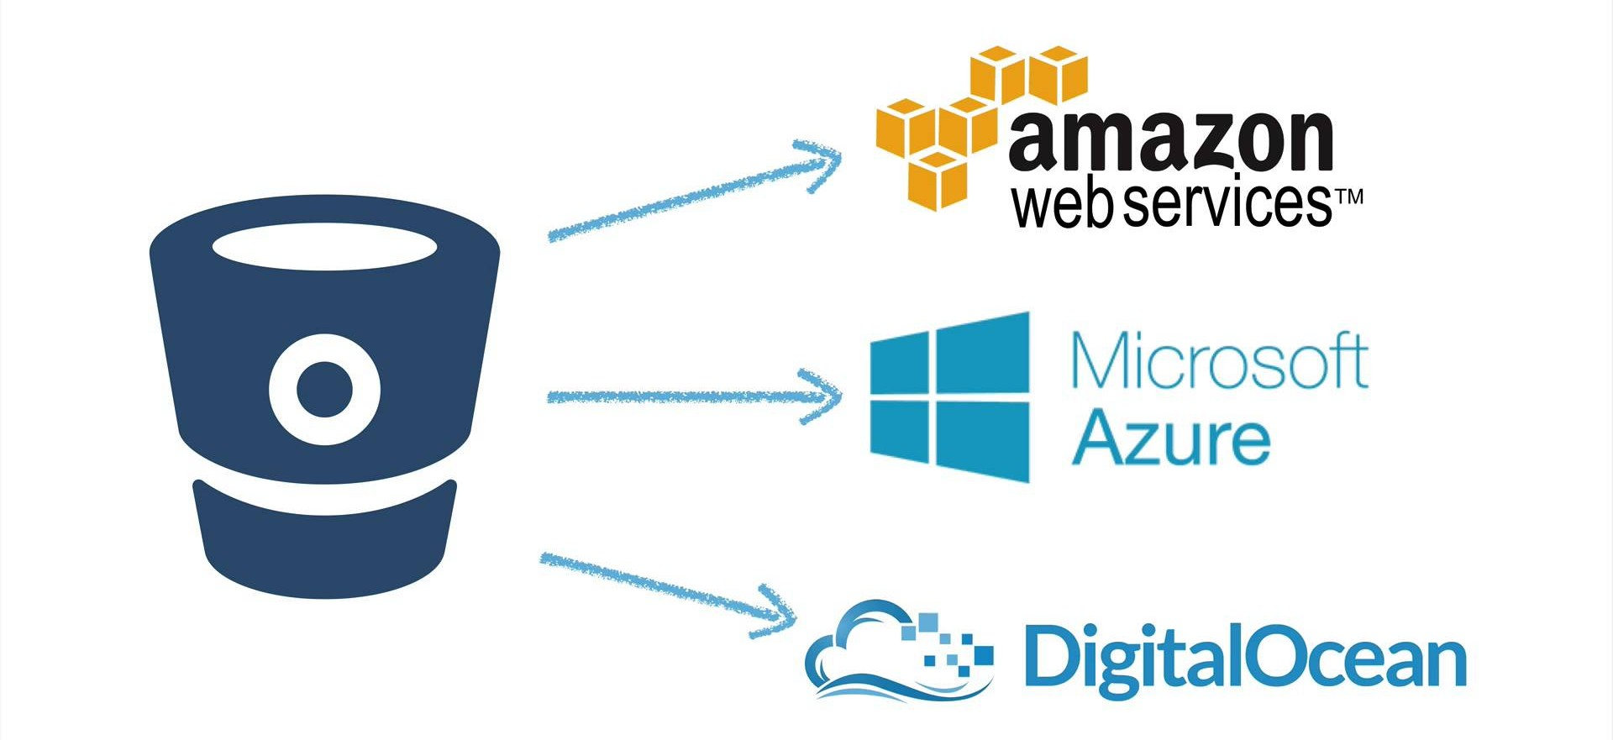
Docker Swarm

Slide 102
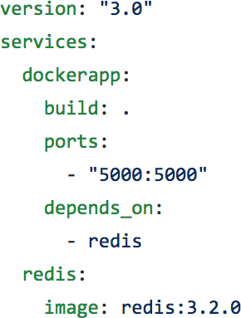
Docker Services
The services can be defined in our Docker compose file.
The service definition includes which Docker images to run, the port mapping and dependency between services.

Slide 103
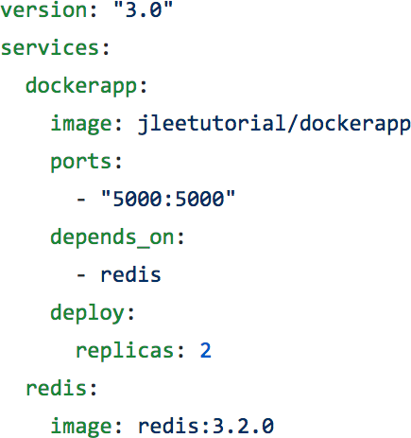
Docker Services
When we are deploying services in the swarm mode, we can also set another important configuration, which is the deploy key and it is only available on Compose file formats version 3.x and up.
The deploy key and its sub-options can be used to load balance and optimize performance for each service.

Slide 104
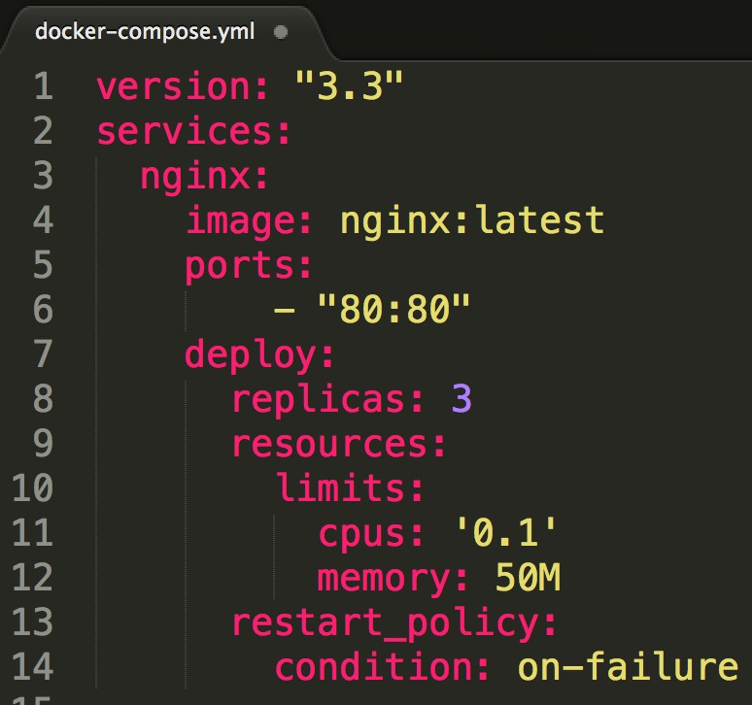
Deploy Key in Docker Compose file

Slide 105
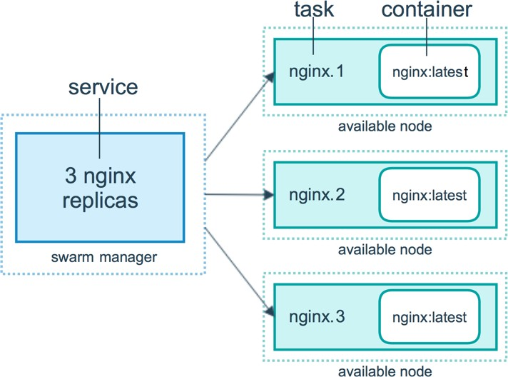
Replicas

Slide 106

Replicas
80
80
80

Slide 107

Replicas
We can connect to the nginx service through a node which does NOT have nginx replicas.
80
Ingress load balancing
80
All nodes listen for connections to published service ports.
When that service is called by external systems, the receiving node will accept the traffic and internally load balance it using an internal DNS service that Docker maintains.
80
80

Slide 108
Docker Stack
A docker stack is a group of interrelated services that share dependencies, and can be orchestrated and scaled together.
You can image that a stack is a live collection of all the services defined in your docker compose file.
Create a stack from your docker compose file:
docker stack deploy
In the Swarm mode,
Docker compose files can be used for service definitions.
Docker compose commands can’t be reused. Docker compose commands can only schedule the containers to a single node.
We have to use docker stack command. You can think of docker stack as the docker compose in the swarm mode.

Slide 109
How to update our services in Production?

Slide 110
Provision a Swarm Cluster
Step 1: Deploy two VMs, one will be used for the Swam manager node, and the other one will be used as a worker node.
Step 2: Appoint the first VM as Swarm manager node and initialize a Swarm cluster.
docker swarm init
Step 3: Let the second VM join the Swarm cluster as a worker node.
docker swarm join

Slide 111
Provision a Swarm Cluster
Step 1: Deploy two VMs, one will be used for the Swam manager node, and the other one will be used as a worker node.
Step 2: Appoint the first VM as Swarm manager node and initialize a Swarm cluster.
docker swarm init
Step 3: Let the second VM join the Swarm cluster as a worker node.
docker swarm join

Slide 112
Provision a Swarm Cluster
Step 1: Deploy two VMs, one will be used for the Swam manager node, and the other one will be used as a worker node.
Step 2: Appoint the first VM as Swarm manager node and initialize a Swarm cluster.
docker swarm init
Step 3: Let the second VM join the Swarm cluster as a worker node.
docker swarm join

Slide 113
Docker Swarm commands
docker swarm init
Initialize a swarm. The docker engine targeted by this command becomes a manager in the newly created single-node swarm.
docker swarm join
Join a swarm as a Swarm node.
docker swarm leave
Leave the swarm.

